Slide 1
Exceptions in python
Helge Fredriksen

Slide 2
Difference between error and exception
Errors are serious runtime environment problems
Out of memory
Stack overflow
Syntax error
These can seldom be fixed, and leads to system failure in some way
Might be logged at outermost level in the application
Exceptions however can happen on a regular basis and must be handled appropriately without a system crash

Slide 3
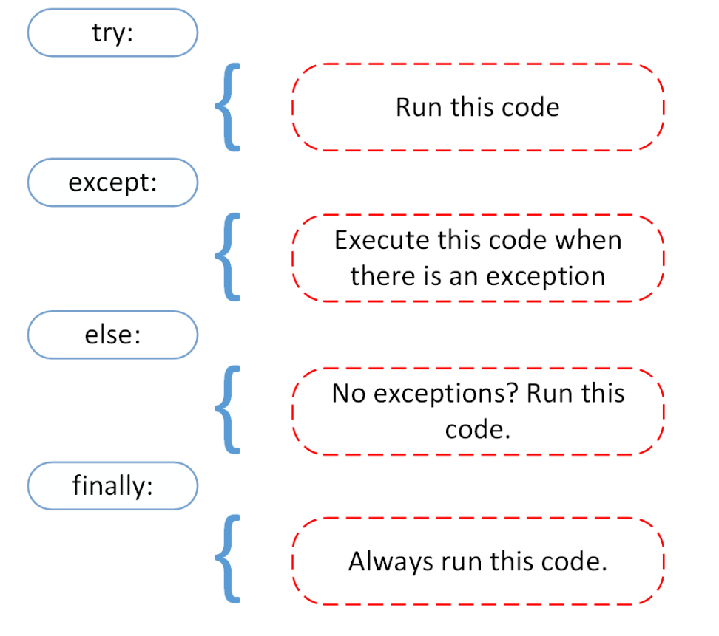
Strukturen

Slide 4
Assert
Syntax: assert statement, <message>
Used to produce tests
Can also be catched through AssertionError
try:
assert variable == 256432
except AssertionError:
print ("There is some problem!")
raise
Output:
There is some problem!
Traceback (most recent call last):
File "Desktop/Tut.py", line 2, in <module>
assert 1 == 2
AssertionError

Slide 5
Raise
Raise exceptions on custom exceptions in your own code
Either by your own exception classes
...Or by re-using some built-in exception classes
Re-raise exceptions in except scopes if you can’t handle all aspects of it locally
If you choose to re-raise an exception in a except block, do not log it as well…
Makes it difficult for the guy debugging…

Slide 6
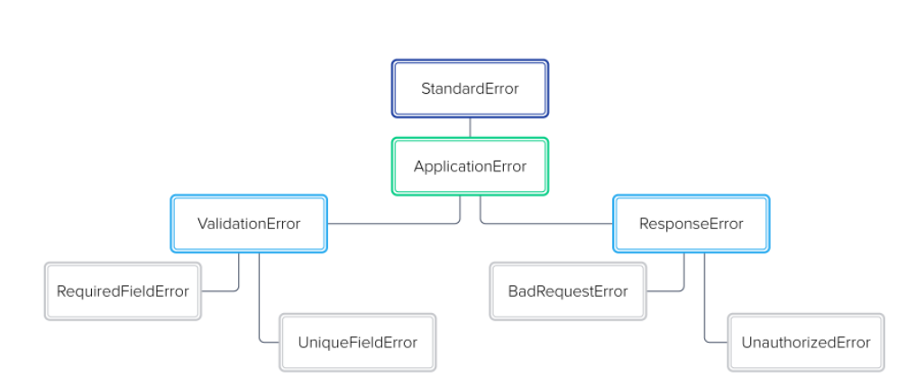
Your own hierarchy

Slide 7
Best practices
Never do flow-of-control inside a except() block!
Will make your code messy and unreadable
Important to keep the stack trace for debugging!
Built-in logging module has functionality for this
Handle specific exceptions you expect in separate except scopes
Catch the type of exceptions you can handle
Pass the rest up in the call stack
Always clean up after handling exception (closing stuff in finally)

